Slide 1
PUCKFish
Preliminary Design Review
Will Aracri, Peter Ha, Ammar Hussain, Alex Necakov, Victoria Thomas

Slide 2
Introduction
Fisheries have a regulatory cap on how many traps they can place, and where they can be placed
Trappers are forced to guess at lobster clusters
There is no effective way to optimise trap placement without up to date data
Trappers currently make heavy use of incomplete, unreliable historical data
No solution to trappers’ data needs exists
Notes:
Will

Slide 3
Problem Statement
In order to preserve the North American right whale population, trappers are limited by the amount of traps that they can deploy by regulation which limits their ability to achieve high catch yields
There is little data to support where trappers should drop traps, wasting time through trial and error
Mounted onto lobster traps, PUCKFish will house sensors that collect vital data on lobster ecosystems which then can be fed to a model provided by our clients in order to provide the optimal fishing locations, thus increasing catch yield
Notes:
Victoria

Slide 4
Requirements
Collect information about water in area around trap
Dissolved Oxygen
Depth
Salinity
Temperature
Water Current Velocity
Ambient Light
Poll sensors at least once per hour
Last 10 days off of a single charge
Compact form factor
Rechargeable with shipboard marine batteries
Be robust enough to withstand constant marine conditions
Automatically detect when the trap surfaces/descends
Transmits data to shipboard base station when trap surfaces, stored in common devices and formats.
Unit cost < $50 at scale, $150 for prototype
Notes:
Victoria

Slide 5
Deliverables
Three PUCKFish underwater sensing devices
Base station for data transmission
Easy charging solution
Accompanying documentation
Notes:
Victoria

Slide 6
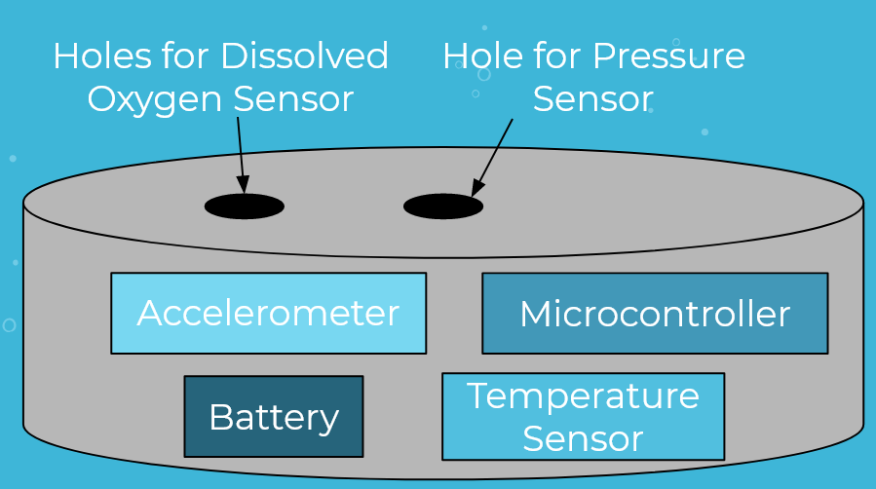
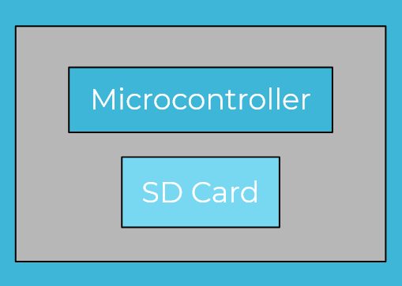
Visualization
Overview of Puck
Overview of Base Station

Slide 7
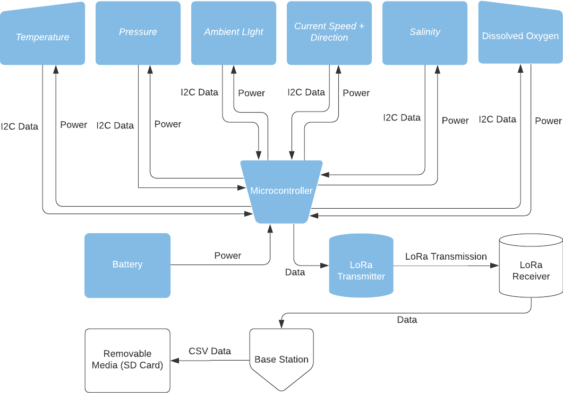

Slide 8
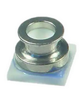
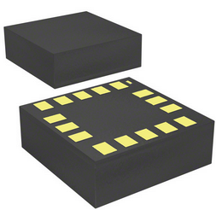
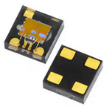
Technology Overview - Sensors
Dissolved Oxygen - In progress
Low cost (premade solutions cost >$100)
Either exposed to exterior or have low power draw for optical sensing
Salinity - In progress
Exposed to exterior
Calibrate electrodes correctly
Water Current Velocity - ICM-20608-G (IMU)
Give reasonable data underwater
Operate while in liquid and tethered to buoy line/lobster trap
Depth - MS583730BA01-50 (Also Temp sensor)
Exposed to exterior (water proof)
Operate at 30 bar pressure and low temp
Temperature - MS583730BA01-50 (same)
Avoid temperature bleed from rest of unit
Operate at range expected underwater (-55C)
Ambient Light - LTR-329ALS-01
Avoid light bleed from other sensors (dissolved O2)
Behind waterproof cover to get reading

Slide 9
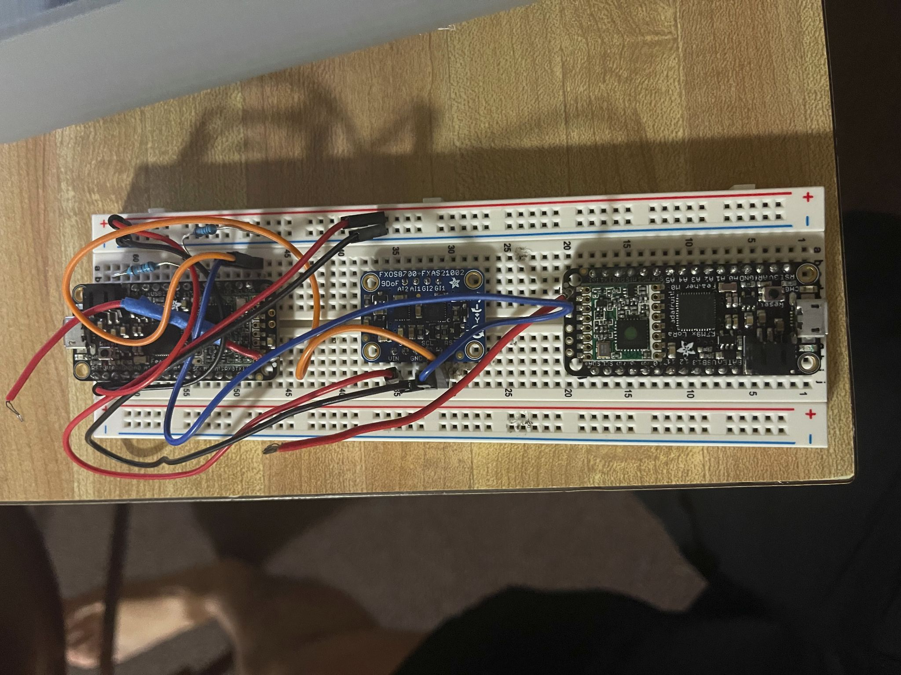
Technology Overview - Prototype Puck 𝛍C, Radio, and Power
IMU: FXOS8700 + FXAS21002
Prototype board, will be using cheaper option in the future
Microcontroller: Feather M0 ATSMD2118
Use same microcontroller, but stip down to essential components
Radio: RFM9x LoRa 915
Use same radio in full model, works at range
Battery: Anker 2500 mAh
Temporary battery for testing, can get away with much smaller LiPo battery to integrate in final model
Notes:
Alex

Slide 10
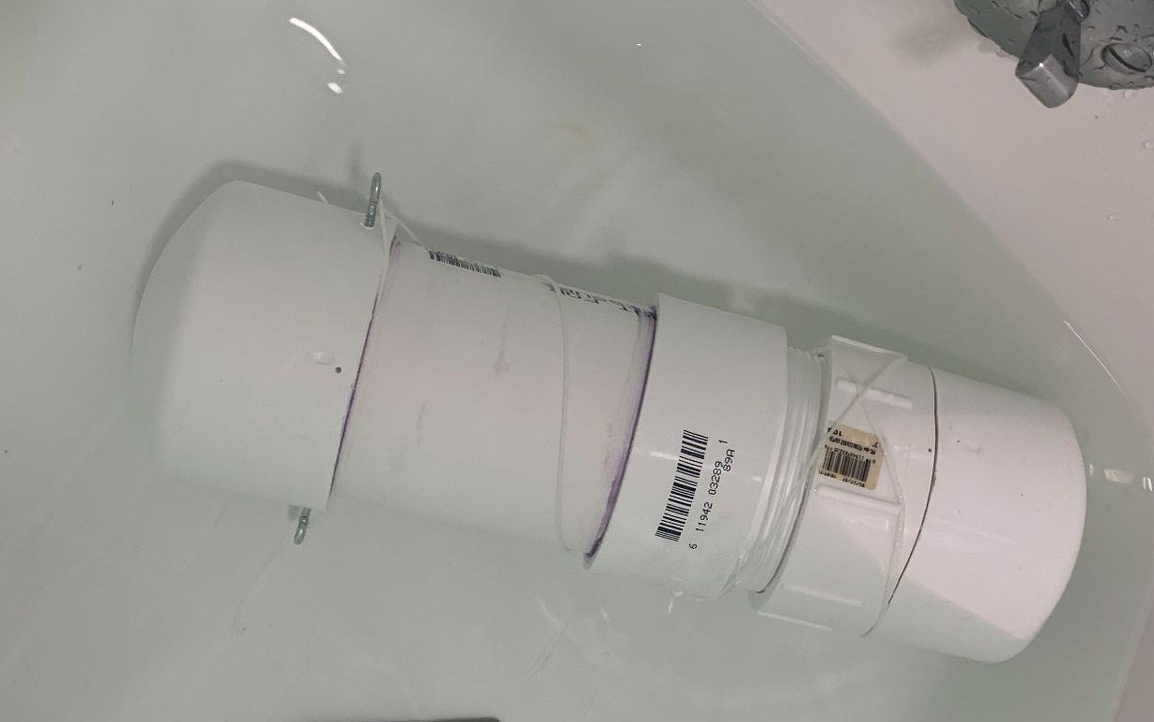
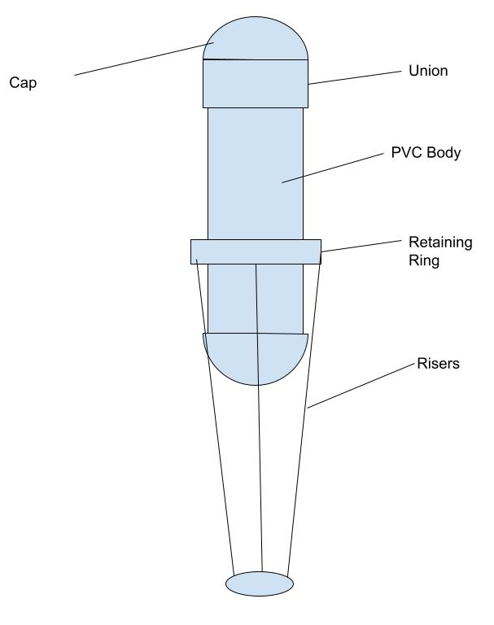
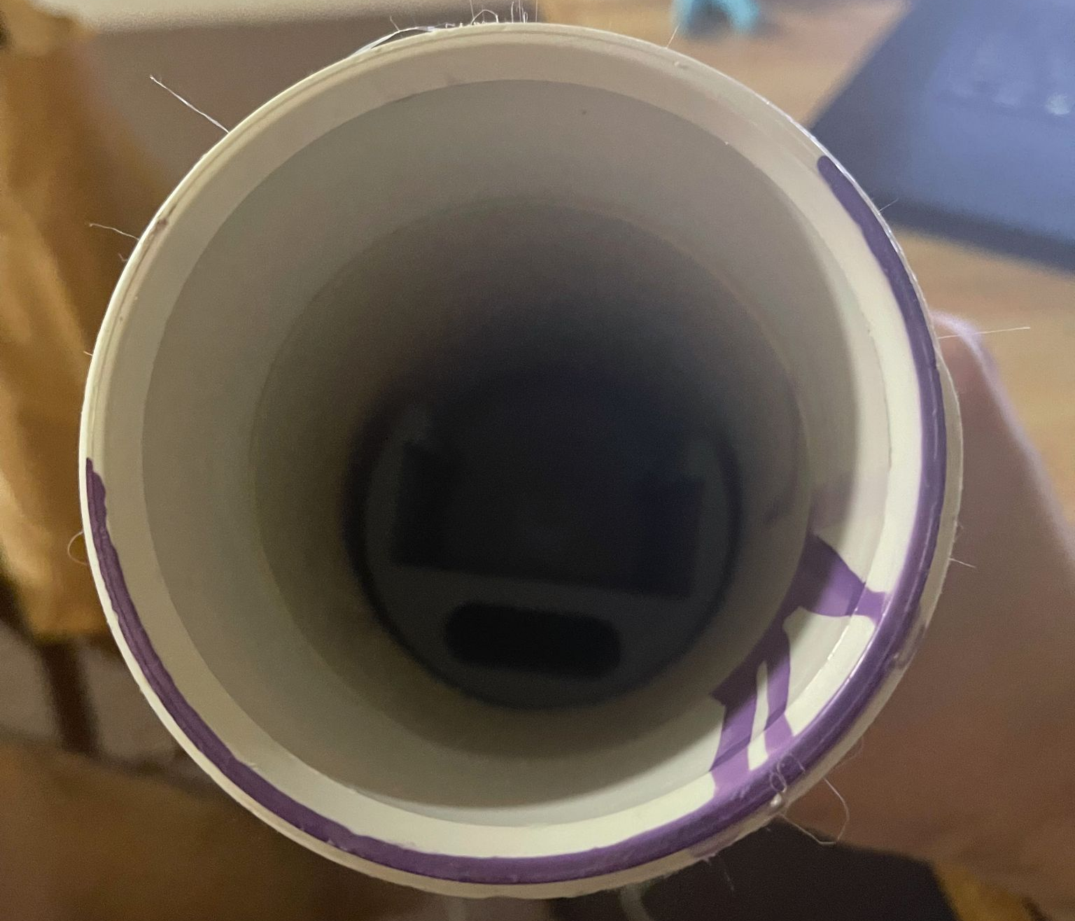
Technology Overview - Puck Outer Casing
Our prototype housing is watertight at shallow depths
The final PUCKFish housing is most likely going to be epoxy, totally encasing the electronics
This is common in industry, where high pressure, waterproof, corrosion-resistant housings are necessary
This would also allow huge flexibility in the mounting of instrumentation that needs seawater access, without compromising other electronics
Pill Casing in Water
Inside of Pill Casing
Diagram of Casing
Notes:
Peter

Slide 11
Technology Overview - Charging and Power
Contact based charging ports will inevitably fail
Salt water will eventually intrude
Covers would require regular maintenance
Existing ruggedized solutions aren’t designed for deepwater pressures
Unergonomic, inconvenient solutions won’t be used by fisheries
Wireless charging removes a point of failure
Allows charging without any physical risk
Potentially need to license the technology
Unfamiliar technology
Battery
Use a LiPo battery
Make sure it works at temperature
Preliminary calculation says we can get away with 500 mAh, but further calculations may be needed
Notes:
Peter

Slide 12
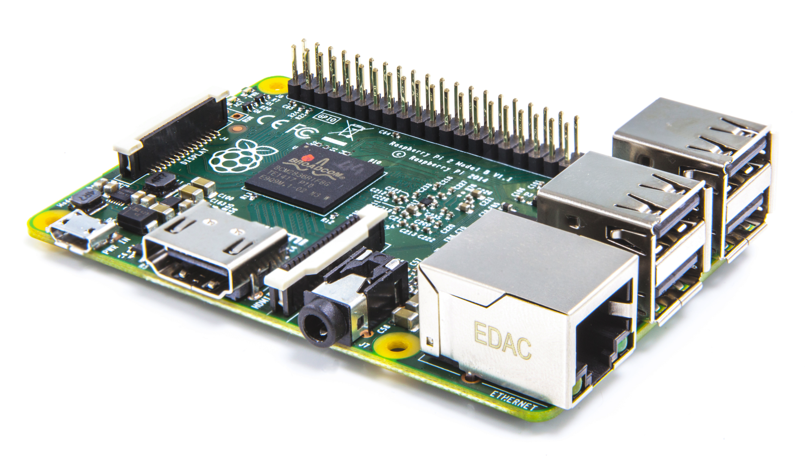
Technology Overview - Base Station
Using a Raspberry Pi with LoRa radio connected to it
Save data to SD card for use with data analytics
Very lightweight, may downgrade the Pi to something cheaper
Notes:
Alex

Slide 13
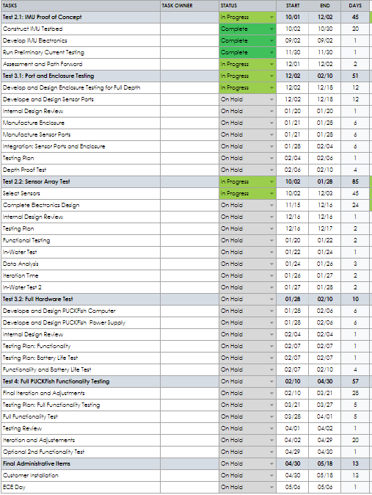
Schedule: Task List
Notes:
Will

Slide 14

Schedule: Gantt Chart
Notes:
Will

